Slide 1
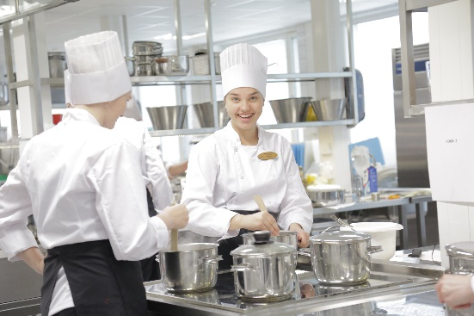
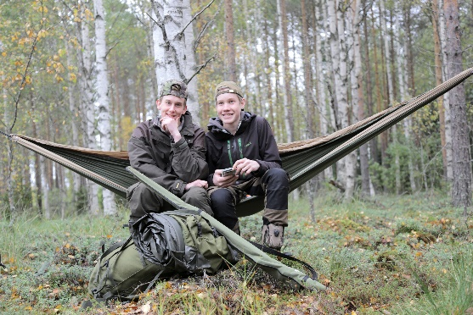
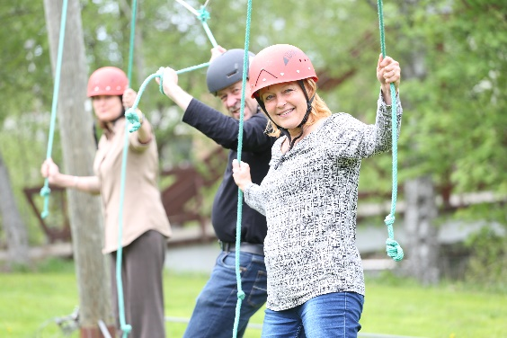

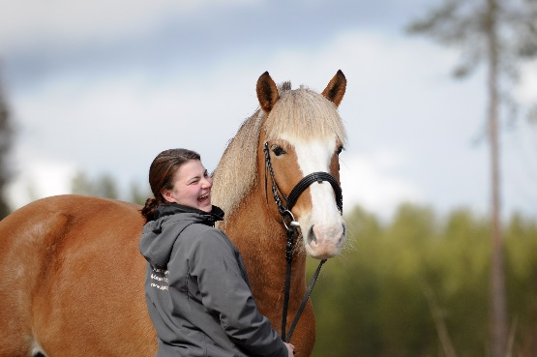

KPEDU
KESKI-POHJANMAAN KOULUTUSYHTYMÄ
KESKI-POHJANMAAN AMMATTIOPISTO

Slide 2
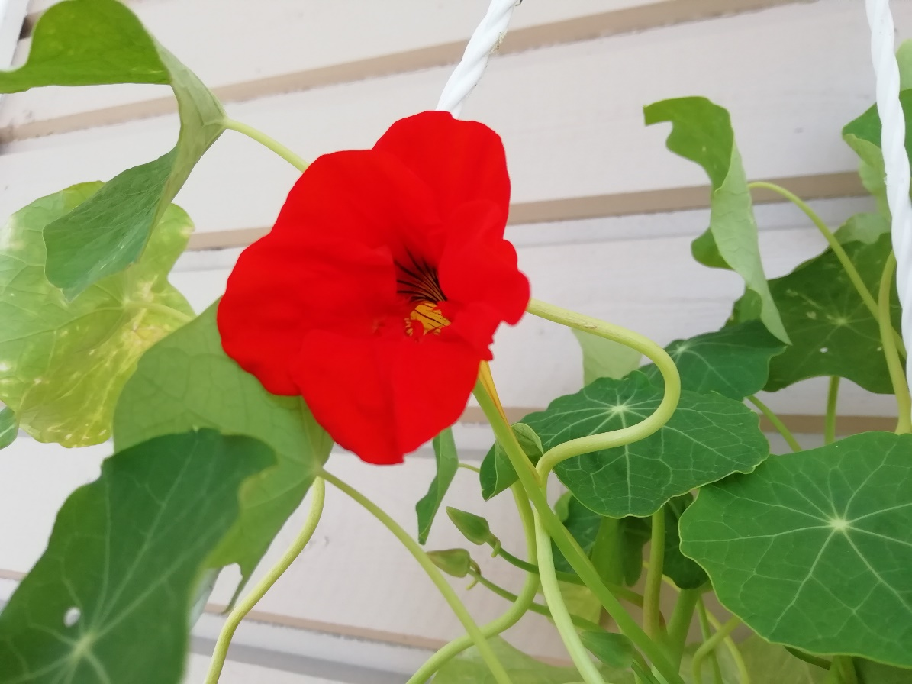
Student welfare in vocational schools
The Wellbeing Services County of Central Ostrobothnia covers the costs and they are located at our school
Nurse
Curator, school social worker
Doctor, Psykiatric nurse
Student welfare psychologist
The local parish funds the educational institution pastor, and the City of Kokkola funds a youth outreach worker.”
The educational institution employs and funds teaching and guidance staff, including study counsellors, special education teachers, student wellfare coordinator, catering staff, property maintenance staff, and administrative staff.

Slide 3



Ways to help students
Studet wellfare, Suport ja special support

Slide 4
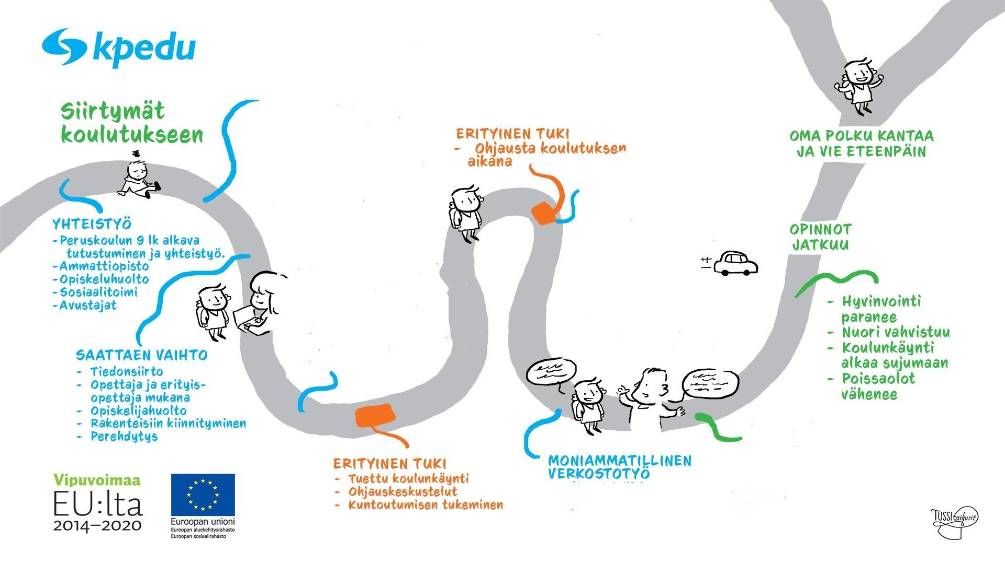
Groupings lobby events, Personal plans, special support, study guidening, curator, psychologist, nurse
Groupings, lobby events,
Personal plans, special support study guide curator, psychologist nurse
Your own path takes you and moves you forward
Transitions to school cooperation with
elementary school and transfer of information
for students who need support
The studies continues
Joint application, continuos application
Special support subsidized schooling supporting rehabilitation
Well-being improves The youth is getting stronger Going
to school is going well absenteeism decreases
Multiprofessional cooperation

Slide 5

Amis Gaala
Dance happening

Slide 6
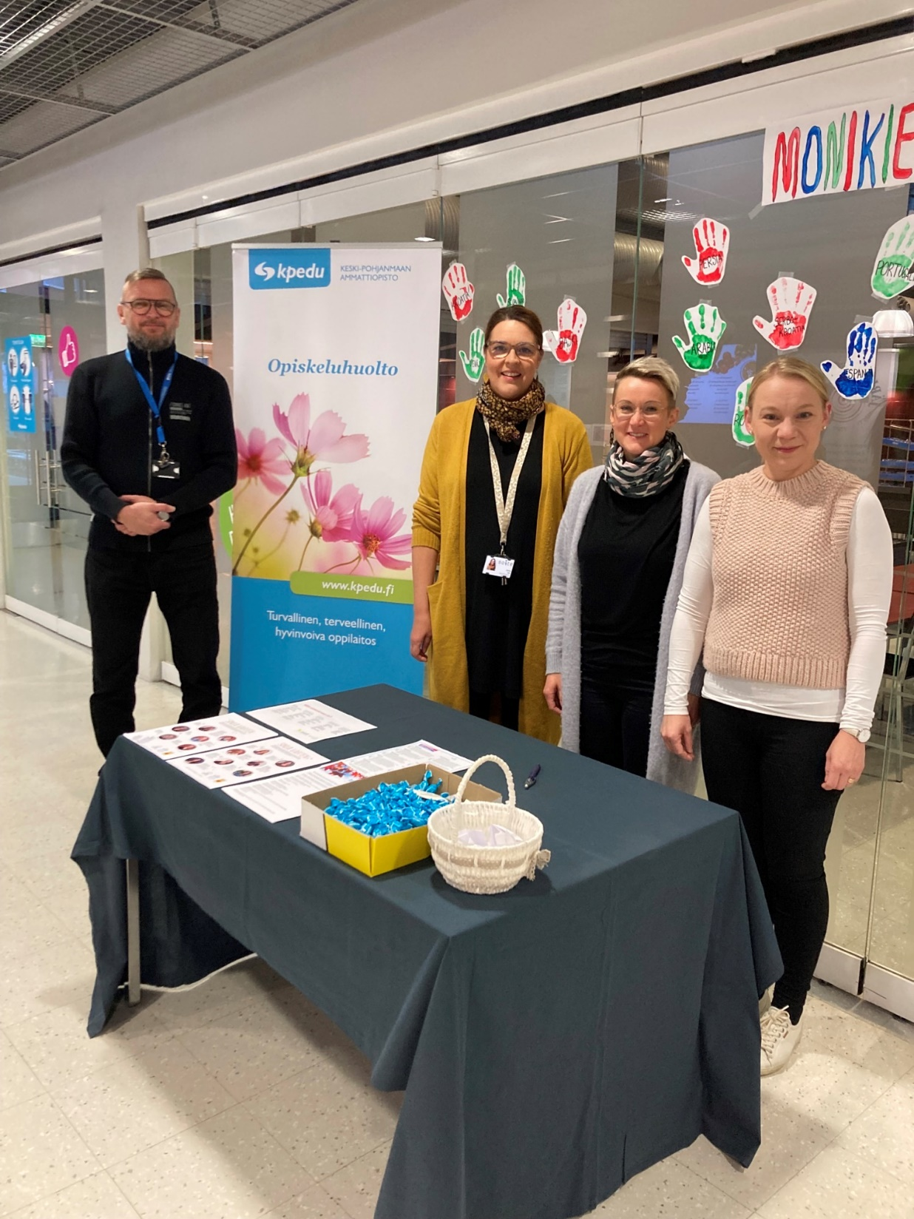
Social break activities

Slide 7
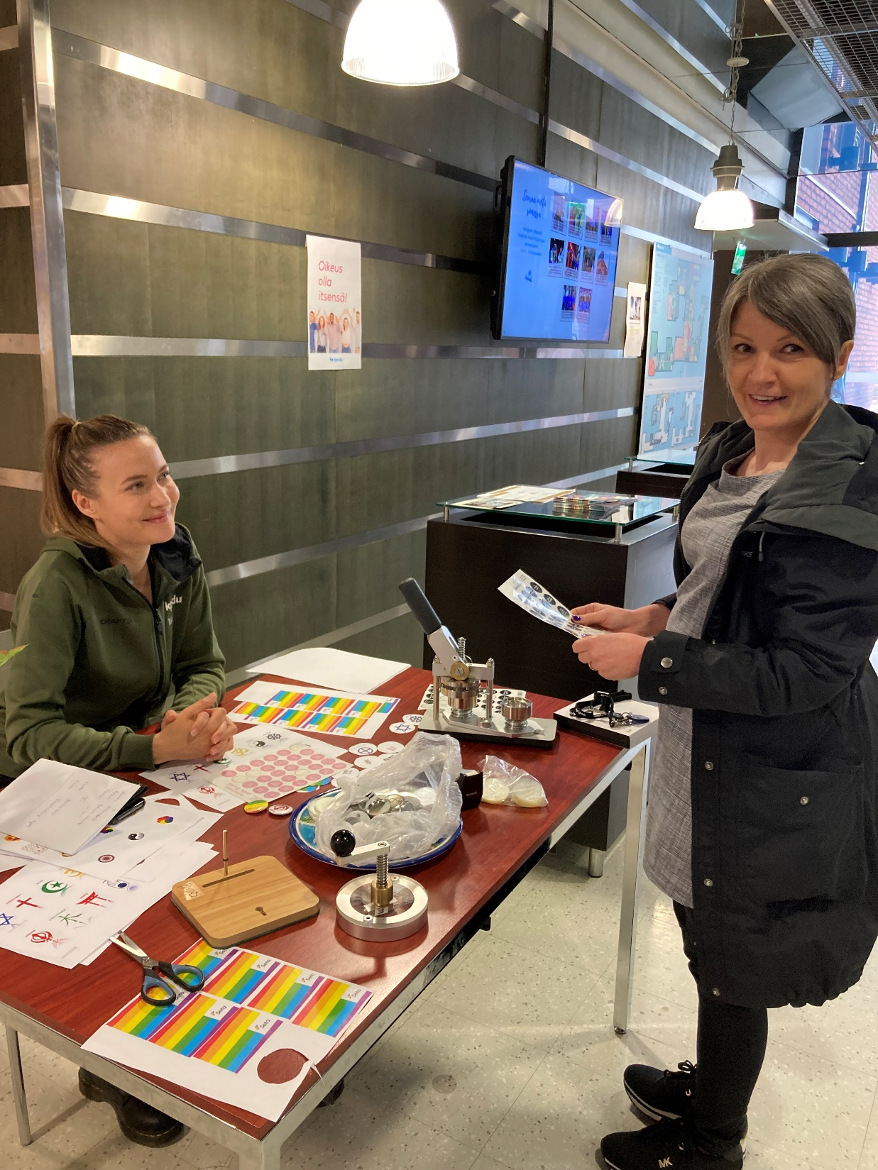

Slide 8
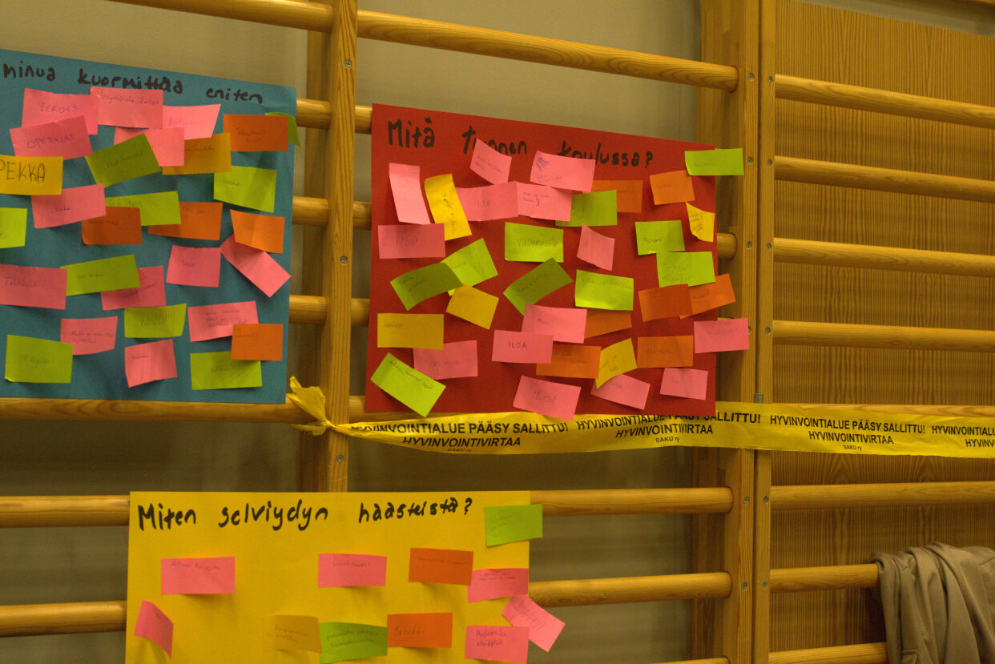


Slide 9
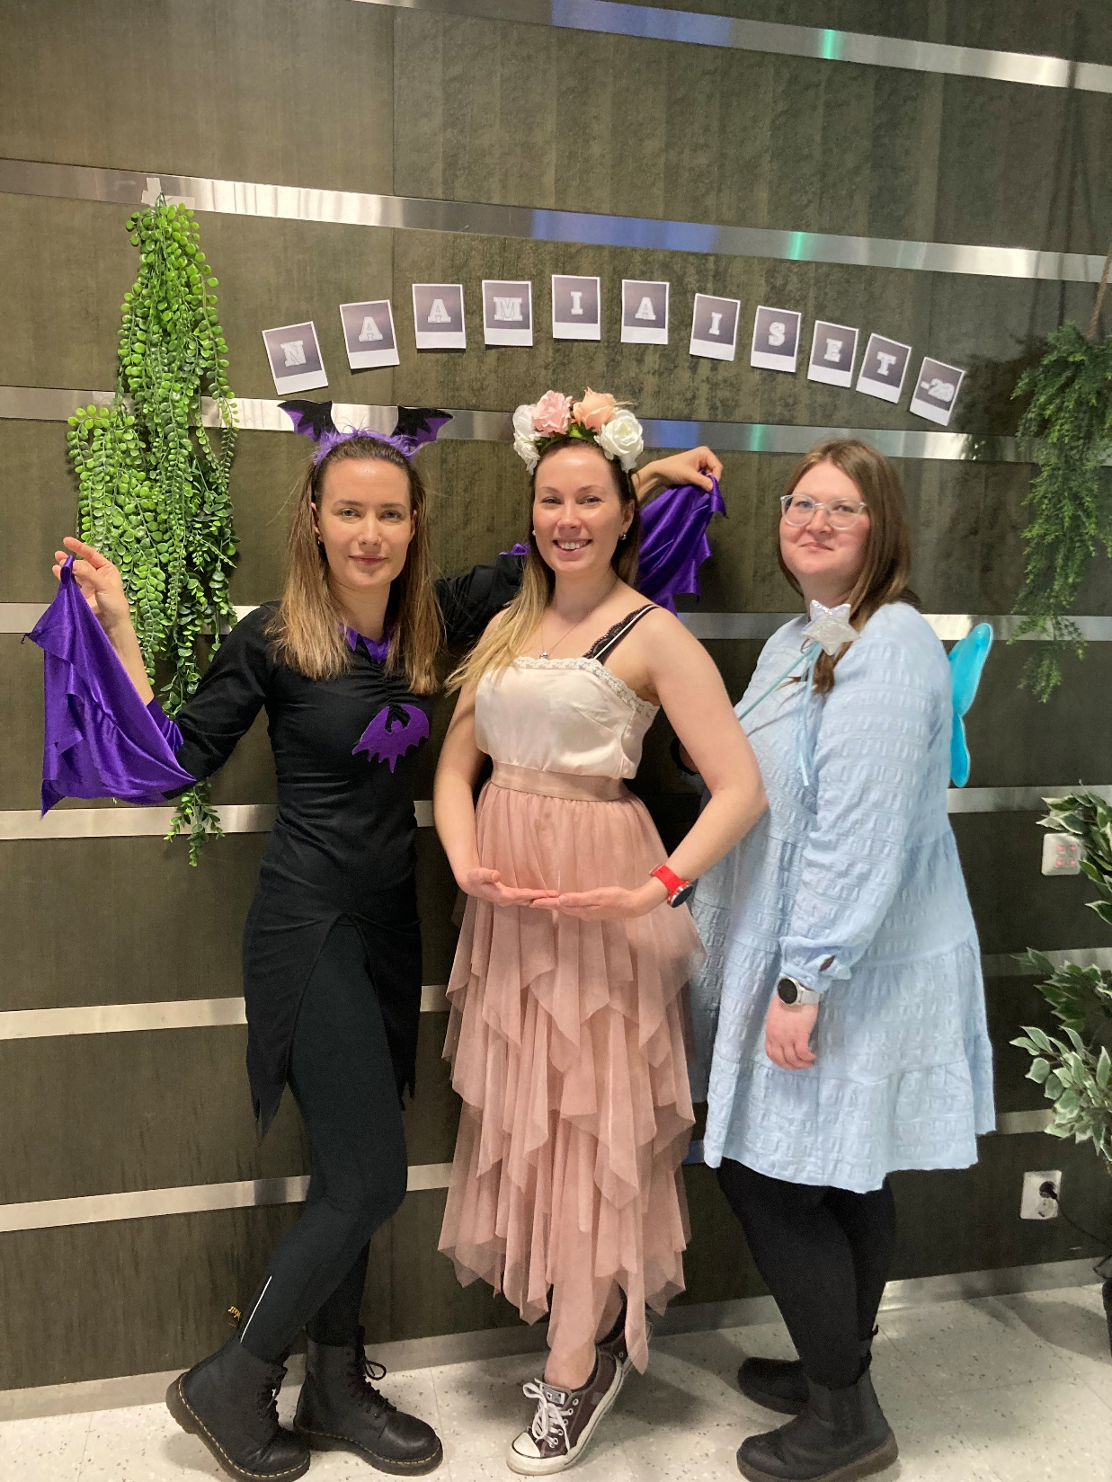
Costume events

Slide 10
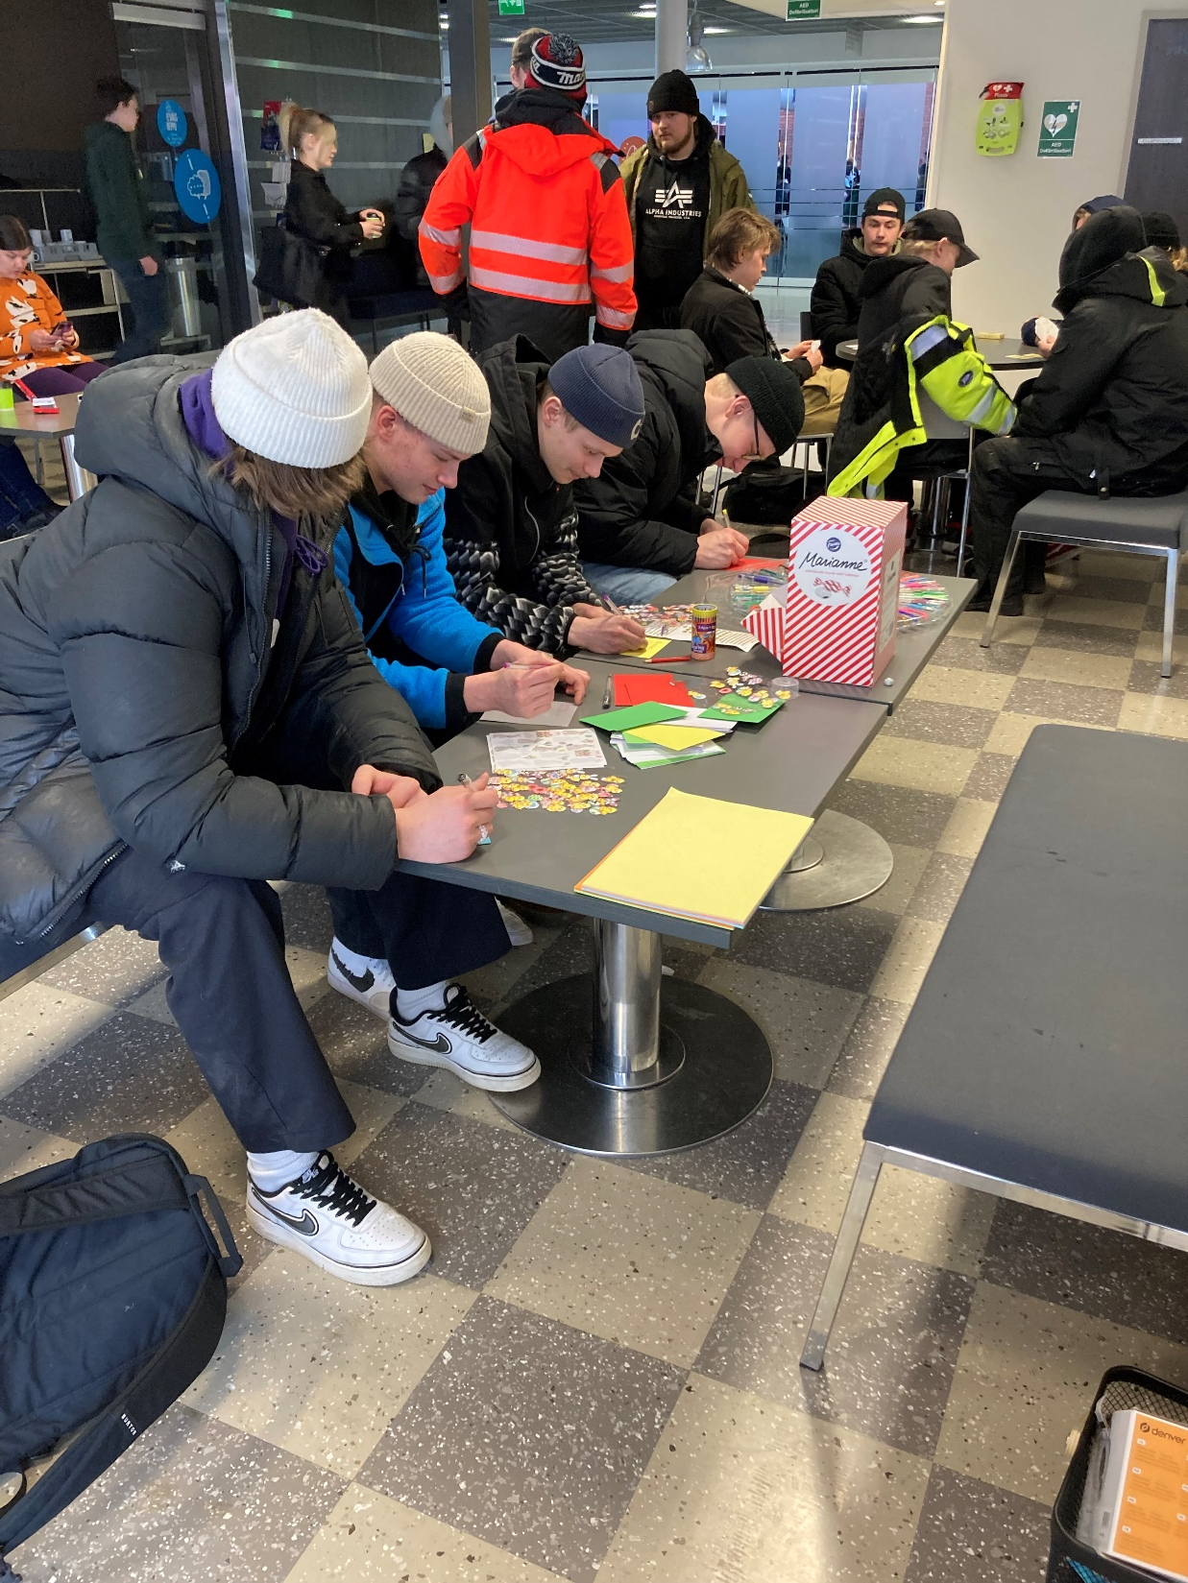
Arts and crafts

Slide 11
Preventing early school leaving
Early Intervention Programs: Implement early identification systems to identify students at risk of dropping out. Intervene as soon as signs of disengagement or academic struggle emerge.
Individualized Support: Provide personalized support and counseling to students based on their needs and circumstances. This may include academic tutoring, career guidance, mental health counseling, and socio-emotional support.
Strong Teacher-Student Relationships: Encourage positive relationships between teachers and students. When students feel supported and valued by their teachers, they are more likely to stay engaged and motivated.
Relevant and Engaging Curriculum: Ensure that the curriculum is relevant to students' interests, career goals, and local job market demands. Incorporate hands-on learning experiences, real-world projects, and opportunities for skill development.
Work-Based Learning: Offer work-based learning experiences such as internships, apprenticeships, and job shadowing. These opportunities allow students to apply their skills in real workplace settings, making their education more meaningful and practical.
Flexible Learning Pathways: Recognize that students have diverse learning styles, interests, and life circumstances. Provide flexible learning pathways that accommodate different pace and learning needs, such as blended learning, competency-based education, and alternative scheduling options.
Parent and Community Involvement: Engage parents, guardians, and community stakeholders in supporting students' educational journey. Provide resources and workshops to help parents understand the importance of education and how they can support their child's academic success.

Slide 12
8. Monitoring and Tracking Systems: Implement systems to monitor students' attendance, academic progress, and social-emotional well-being. Use data to identify trends and patterns that may indicate students at risk of dropping out, and intervene accordingly.
9. Transition Support: Provide support for students transitioning between school levels (e.g., middle school to high school) or into the workforce. Offer transition programs, mentoring, and resources to help students successfully navigate these transitions.
10. Collaboration with Employers and Industry Partners: Collaborate with local employers and industry partners to align curriculum with industry needs, provide internship opportunities, and facilitate job placement for graduates. This strengthens the connection between education and employment, motivating students to stay in school to pursue their career goals.
11. Continuous Professional Development: Provide ongoing training and support for teachers and staff to enhance their ability to support students at risk of dropping out. This may include training in counseling techniques, cultural competence, trauma-informed practices, and effective classroom management strategies.

Slide 13
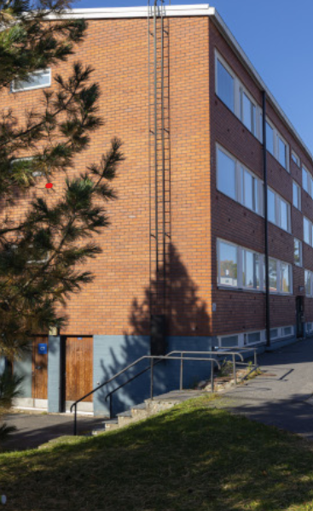
Dormidory
https://www.kpedu.fi/hakijalle/opiskelu-ja-asuminen
Kpedu organizes training at six locations. Through the links below, you can find location-specific

Slide 14
Dormidory
Living in a dormitory promotes a young person's independence in a safe manner.
The goal is to support the student's progress in their studies and guide them in learning and managing daily life skills. Dormitory instructors work in the dormitories, ensuring the implementation of dormitory activities that promote safety, health, well-being, and the ability to study as part of student welfare services.
The Central Ostrobothnia Vocational College (Kpedu) has dormitories in Kokkola, Kälviä, Kannus, Kaustinen, and Perho. A
ccommodation in them is primarily intended for students under compulsory education.
Dormitory places are always temporary, usually granted for one academic year at a time.
Accommodation is free of charge for vocational college students and compulsory education students at the folk high school. In Kälviä, the folk high school dormitory also hosts weekend course participants, campers, and other external accommodation clients throughout the year.

Slide 15
How a Dormitory Instructor Supports Students
A dormitory instructor (asuntolaohjaaja) supports students in various ways during their daily lives. Their role is to be a safe adult who helps with gaining independence and ensuring smooth progress in studies.
🧺 Daily Life Skills and Management
Home care skills: Instructors guide students in cleaning, doing laundry, and keeping their rooms tidy.
Finances and cooking: Students get help with preparing healthy food and establishing regular meal routines.
Daily rhythm: Instructors support maintaining sufficient sleep and a regular daily routine so that the student has the energy to wake up for school.
🌱 Well-being and Study Ability
Listening ear and emotional support: Students can discuss concerns, homesickness, or study stress with the instructor.
Community and free time: Instructors organize group activities, evening snacks, and hobby opportunities, which help students get to know each other and prevent loneliness.
Monitoring studies: Instructors keep in touch with teachers and other student welfare staff if a student needs specific support with their studies.
🛡️ Safety and Rules
Common guidelines: Instructors supervise compliance with the dormitory's code of conduct to ensure a safe and peaceful living and working environment for everyone.
Presence during evenings and nights: Instructors are present at the dormitory when students are there (usually during the evening and night), meaning help is always available when needed.

Slide 16
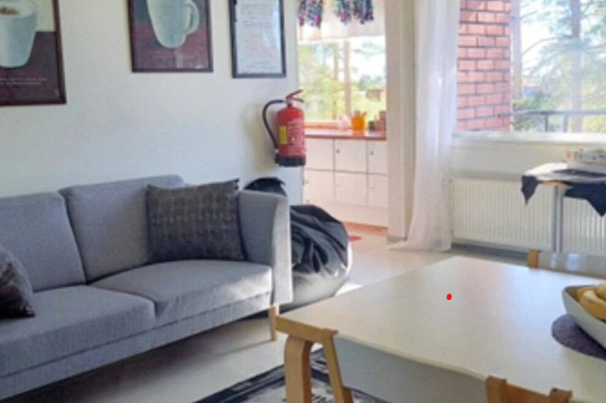
Atsa
Student support apartment ATSA, Kokkola ATSA is a subsidized housing unit for young people,
located in Kokkola on Närvilänkatu in the dormitory of Keski-Ostrobothnia Vocational College.
ATSA is intended for young people who need, among other things, support and guidance in going to school,
managing everyday life, maintaining a circadian rhythm, practicing social skills and spending free time.
The unit has 8 rehabilitation places and the unit is open on school days. There are two instructors, and
they are there from Monday to Thursday between 7:30 and 20:30 and on Fridays between 7:30 and 16:30.

Slide 17
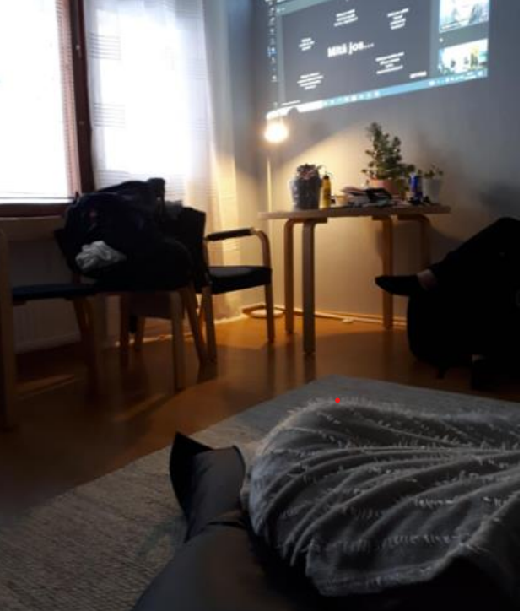
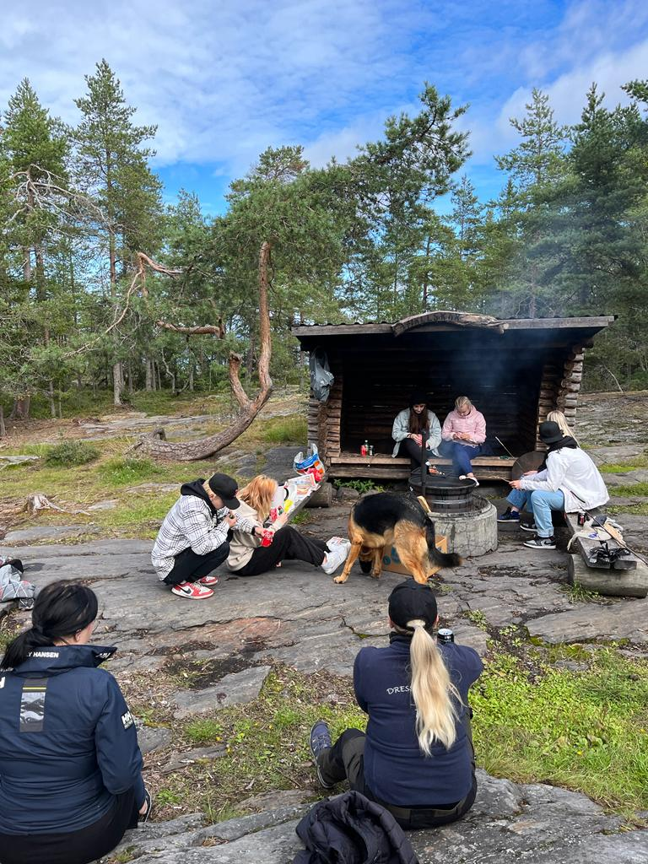

Together we get strent place where you can study when studies are at risk of being interrupted"

Slide 18
Kpedu, resource coaching provides students in need of special support with a calm learning environment where they can practise life management skills and work on their studies. The Resource Learning Environment has been operating at Kpedu since 2022.
“In the home-like Resource Learning Environment, we work with young people who are at immediate risk of dropping out of the education system and being left without an upper secondary qualification,” explains Salla Taskila, a coach in the Yhdessä voimaa opintoihin project.
At the Resource Learning Environment, each day is tailored to the student’s individual needs and current situation, with the aim of helping both their everyday life and studies move forward. Young people often arrive in a situation where they have experienced profound disappointment with their studies and their current circumstances in life.
“It is important that there is an adult who has a comprehensive understanding of the young person’s overall situation. A strong knowledge of the social welfare service system, combined with an understanding of vocational education, is an enormous asset in this work,” says Taskila.
Interventions have been shown to be an effective method for preventing students from dropping out of education. At
Kpedu, we work closely with various stakeholders. Networking with other education providers enables the exchange of good practices and experiences in both directions.

Slide 19
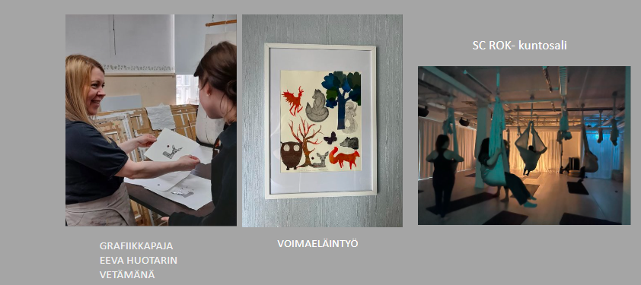

Slide 20
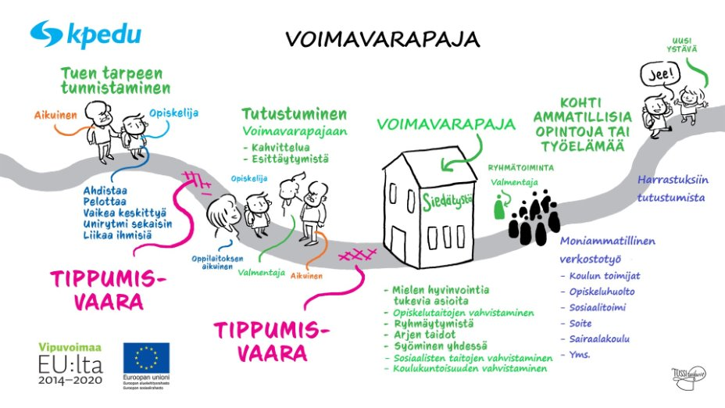

Slide 21
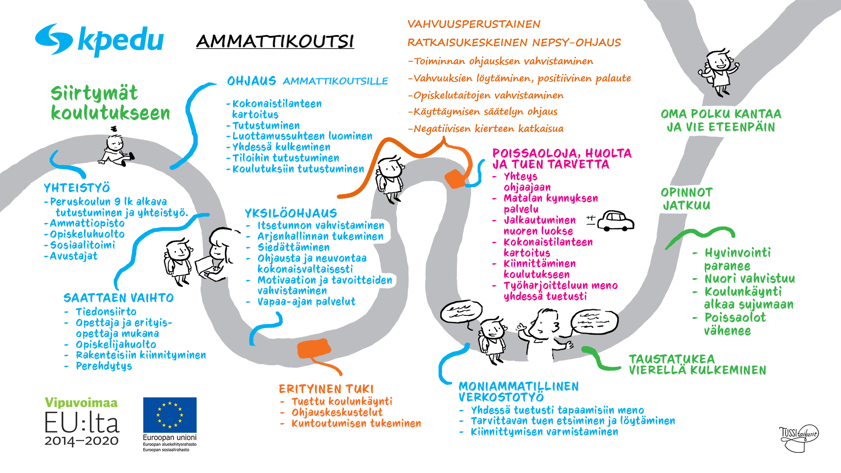
Kpedu:n
Pilotoitu ohjausmalli

Slide 22
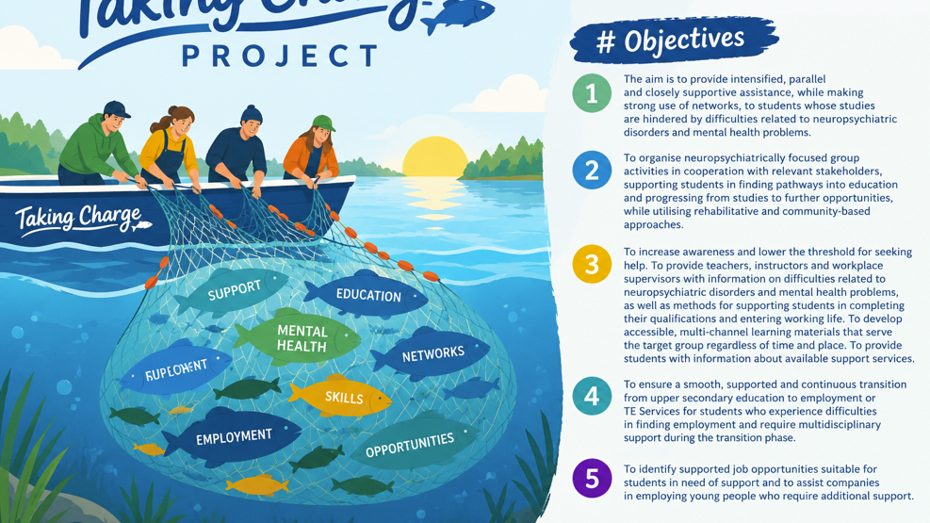


Slide 23
Taking Charge Project
Objectives
Objective 1. The aim is to provide intensified, parallel and closely supportive assistance, while making strong use of networks, to students whose studies are hindered by difficulties related to neuropsychiatric disorders and mental health problems.
Objective 2. To organise neuropsychiatrically focused group activities in cooperation with relevant stakeholders, supporting students in finding pathways into education and progressing from studies to further opportunities, while utilising rehabilitative and community-based approaches.
Objective 3. To increase awareness and lower the threshold for seeking help. To provide teachers, instructors and workplace supervisors with information on difficulties related to neuropsychiatric disorders and mental health problems, as well as methods for supporting students in completing their qualifications and entering working life. To develop accessible, multi-channel learning materials that serve the target group regardless of time and place. To provide students with information about available support services.
Objective 4. To ensure a smooth, supported and continuous transition from upper secondary education to employment or TE Services for students who experience difficulties in finding employment and require multidisciplinary support during the transition phase.
Objective 5. To identify supported job opportunities suitable for students in need of support and to assist companies in employing young people who require additional support.

Slide 24
Main Points of the Nepsy Cards
The Nepsy Cards provide practical strategies to support young people with neurodevelopmental challenges in their studies, daily life, and overall well-being.
1. Supporting Concentration
Choose a place with as few distractions as possible.
Use tools that help maintain focus, such as stress balls, note-taking, or quiet movement.
Drink water regularly.
Take breaks and reward yourself for sustained concentration.
Stay actively engaged and keep your phone out of sight.
2. Supporting Attention and Reducing Mistakes
Read the entire task before starting.
Focus on one thing at a time and work in small steps.
Review your work carefully.
Allow enough time and minimize distractions in your environment.
3. Homework and Exam Preparation
Start working when you are alert and energized.
Choose a suitable time and place for studying.
Break tasks into smaller parts and take regular breaks.
Focus on one task at a time.
Eliminate distractions, especially your phone.
4. Supporting Initiative and Time Management
Plan tasks in advance.
Use calendars, to-do lists, and reminders.
Maintain regular routines.
Ask for help with planning and scheduling when needed.

Slide 25
5. Supporting Memory
Write things down in a calendar, notebook, or digital app.
Use colors, highlighting, and mind maps.
Make use of phone alarms and reminders.
6. Establishing Healthy Sleep Habits
Maintain a regular sleep schedule.
Wind down in the evening and avoid caffeine and energy drinks late in the day.
Reserve your bed for sleeping.
Try to wake up at the same time each day.
7. Healthy Nutrition
Eat regularly, about 4 to 5 times a day.
Choose healthy and varied foods.
Drink enough water throughout the day.
Have snacks available and avoid excessive grazing between meals.
8. Creating a Calm Environment
Keep your surroundings tidy and organized.
Avoid rushing and stick to routines.
Reduce unnecessary stimuli such as noise, messages, and other distractions while working.
Overall Message
The key message of the Nepsy Cards is that concentration, memory, and everyday life management can be strengthened through clear routines, planning ahead, minimizing distractions, and maintaining good sleep, nutrition, and balanced work-break patterns.

Slide 26
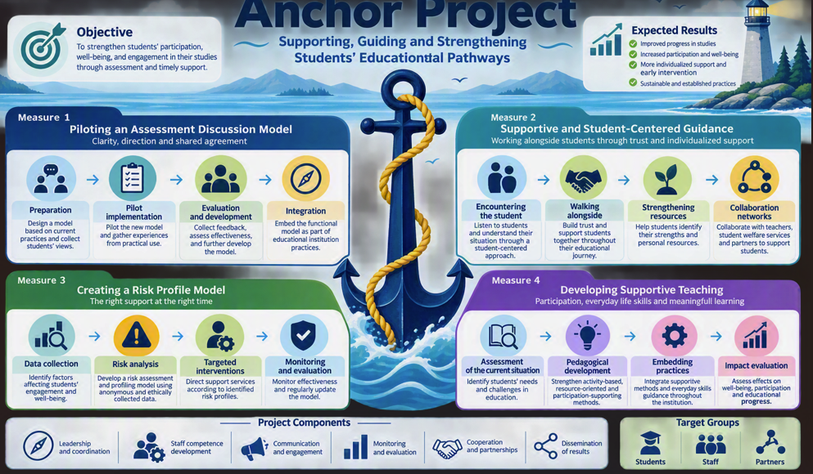

Slide 27
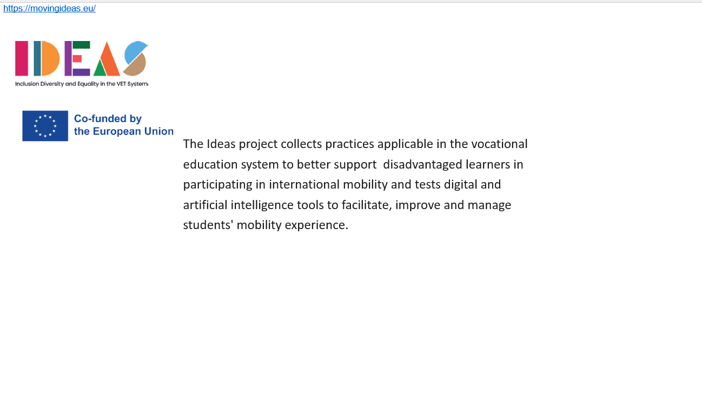

https://allineducation.eu/
Knowledge and Learning:
Sharing knowledge, applying inclusive teaching methodologies, and promoting lifelong learning opportunities represent key actions at the core of the project.
Community and Inclusion:
Creating inclusive learning environments, welcoming and valuing teachers, students, and professionals, and fostering strong educational communities are central priorities.
Communication and Exchange of Ideas:
Facilitating dialogue, promoting collaboration, and encouraging peer exchange enable the development of shared solutions and strengthen connections across diverse contexts.

Slide 28
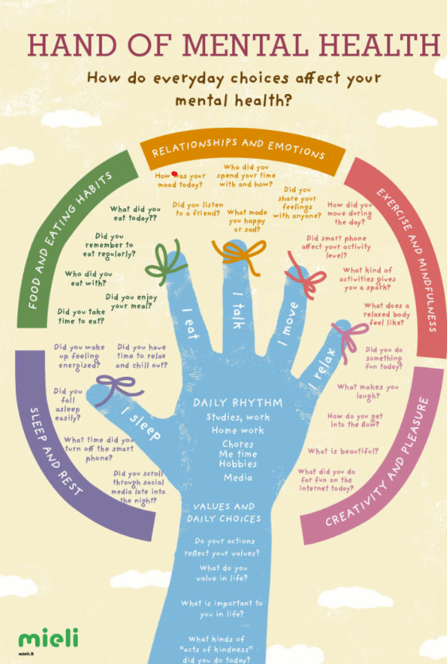
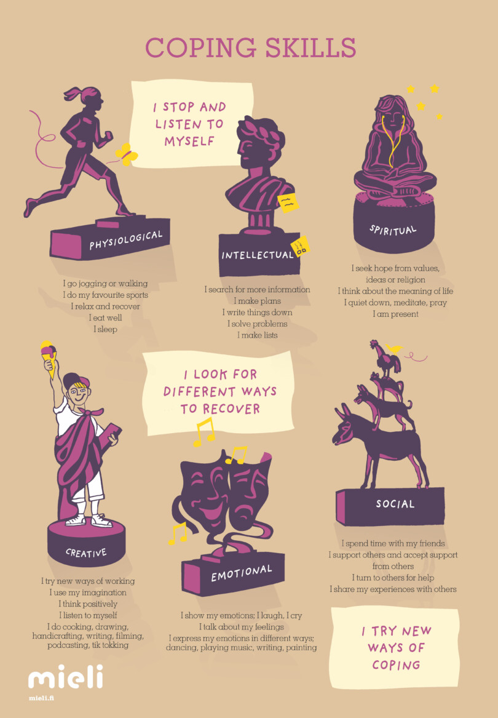

Slide 29
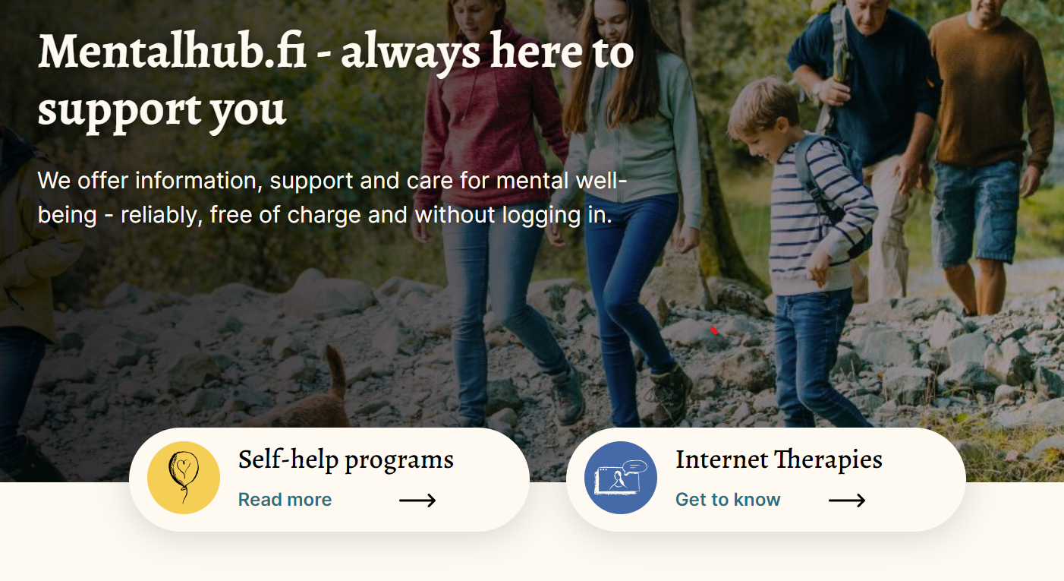

Slide 30
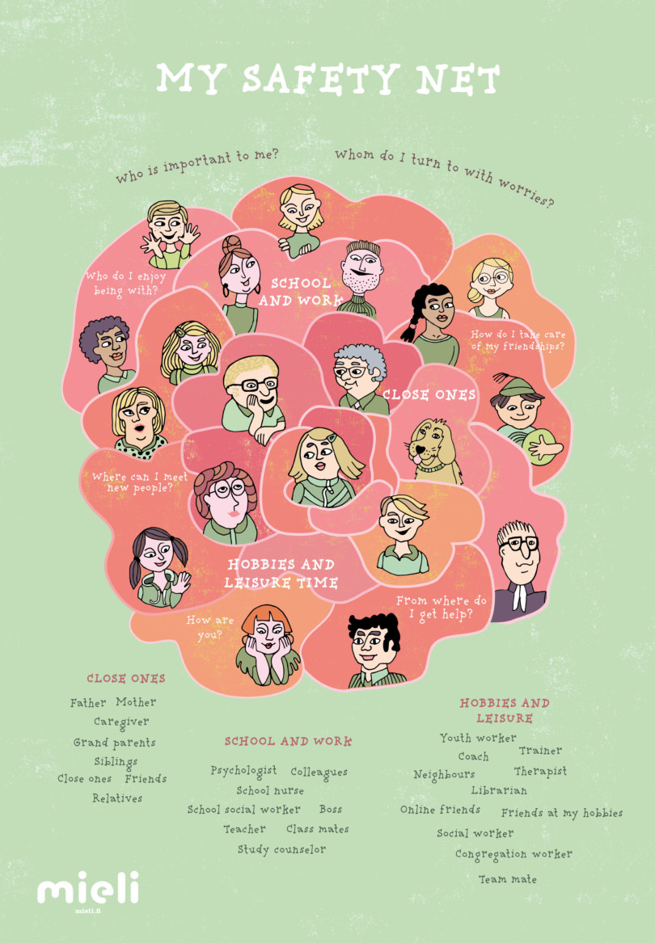
https://mieli.fi/en/materials/
https://www.mielenterveystalo.fi/en
https://www.kpedu.fi/Satoa​
​
https://www.kpedu.fi/AIM​

