Slide 1

Mineral processing
Development of the Extractive Industry in Central Ostrobothnia

Slide 2
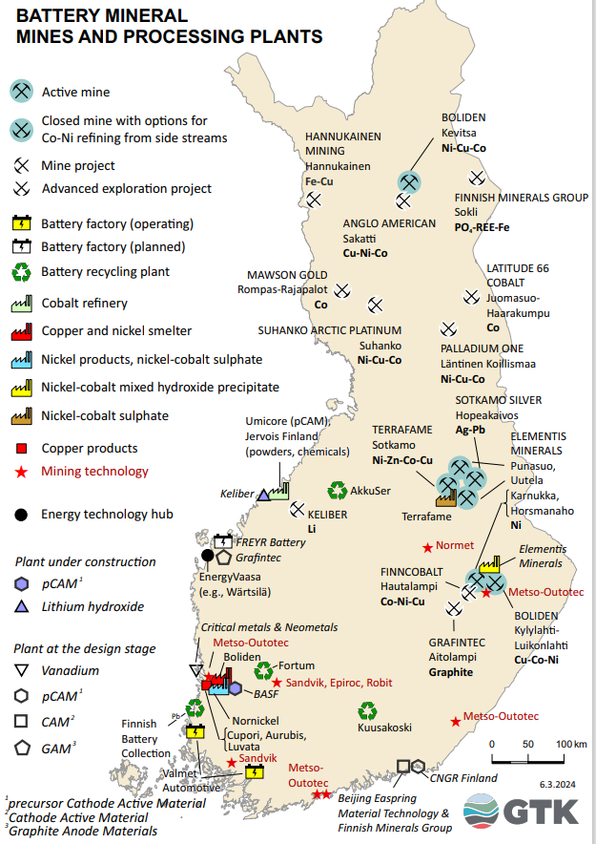
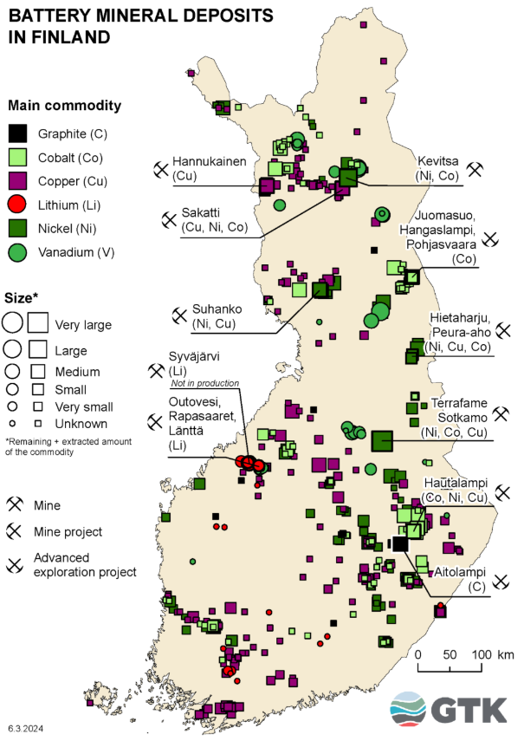

Slide 3
A sample of operating mines
Kittilä, Suurikuusikko: Europe’s largest gold mine, cyanide leaching
Sodankylä, Kevitsa: Large multi-metal mine (Cu, Ni, precious metals), flotation
Kemi: Chromite mine, gravity separation
Terrafame: multi-metal (Cu, Zn, Ni, Co, U), bioleaching and precipitation
Sotkamo Silver: Ag, Pb, Zn, flotation
Dragon Mining: Jokisivu/Huittinen & Sastamala, Au, flotation and gravity separation
Pampalo, gold, gravity separation and flotation
Keliber, Kaustinen (2026 →): Li, flotation

Slide 4
Industrial mineral mines (either flotation or no ore dressing at all):
Nordkalk: Lappeenranta, Parainen, Lohja the largest (lime)
Elementis: Outokumpu ja Sotkamo (talc, Ni as a by-product)
Yara Siilinjärvi: Apatite (P)

Slide 5
Mining projects in Finland
Keliber Oy, Kaustinen & Kokkola
Ilmenite mining project in Keski-Pohjanmaalla
Suhanko mining project at Ranua, Suhanko Arctic Platinum Oy
Kuusamo cobalt mining project, Latitude 66 Cobalt Oy
Rompas&Rajapalot, Ylitornio, Mawson Resources
Hautalampi cobalt mining project, Outokumpu, FinnCobalt Oy
Suomussalmi talc mining project, Tulikivi
Critical Metals (not an actual mining project, but a further processing project)
Ikkari ja Hirsikangas, Rupert Finland Oy
Otanmäki mining project, Otanmäki Mine Oy

Slide 6
Mining projects in Finland
Sokli’s mining project at Savukoski, Suomen Malmijalostus Oy
Siikalatva, Kupukan Grafiitti Oy, graphite
Heinävesi graphite project, Beowulf Mining
Sakatti mining project, Sodankylä, AA Sakatti Mining Oy
Kolari, iron ore mining project, Hannukainen Mining Oy
Several mines especially in the north, have recently increased their production
Diamond mines (Kuhmo, Kaavi)?
Rare earth elements (REE) deposits?
Mining projects in Northern Sweden
Several further processing projects are being planned and constructed around the battery cluster, Suomen Malmijalostus Oy ja BAS

Slide 7
Big picture of the operation
The mining industry has two sectors:
  Metal ore mines
  Industrial mineral mines
Almost every process, especially in the metal ore sector has three basic stages: mine, concentrator and refinery
Of course, for example, in the case of battery cluster, there may be significantly more stages after the mine and the concentrator before we reach the point where we have a finished battery.

Slide 8
Big picture of the operation in the case of battery minerals
Mine (e.g. Ni, Co, Li, Mn, Al and graphite minerals)
Concentrating plant (the above-mentioned minerals, the concentration of which has increased significantly, or e.g. metal sulphides)
Manufacturing of battery minerals (e.g. nickel and cobalt sulphate, lithium carbonate or hydroxide)
Precursor manufacturing (cathode material precursor, e.g. NMC811)
Component manufacturing (anode, cathode, electrolyte)
Manufacturing and assembly of cells
Recycling (generally mechanical processing + hydrometallurgical process) → battery chemicals are obtained

Slide 9
Mining
There are basically two types of mines:
  Underground mines
  Open pit mines
The costs per tonne of ore in an underground mine are much higher (roughly 5 times higher) due to reinforcement among other things, but this is partly a misconception: there is little need to extract waste rock underground, which is practically always necessary in open pit mining.
Mining is becoming electrified, and much of it has already been electrified quite rapidly. In the largest Boliden mines, quarry trucks already draw their energy from the overhead wires in much same way as trams. Much of the underground equipment has already been electric.

Slide 10
Purpose of beneficiation
Why are ores beneficiated?
The ore dressing process achieves the following benefits, among others:
  Further processing costs are reduced as the amount of material to be processed decreases
  Transportation costs are reduced
  Separating valuable substances as minerals into concentrates facilitates metallurgical or chemical processing
Ore dressing technology aims to find methods to answer mainly three questions:
  How to separate minerals in bedrock (comminution)
  How to separate crushed minerals into own products
  How to process the separated minerals into the form required for further processing

Slide 11
Mineralogical conditions for ore dressing
Ore composition and structure
  Ore composition structure and surrounding rock quality
  The microstructure the ore is particular important
  Similarity of properties of ore minerals
  Relantionships between mineral structures (inclusions)
    For example if chromite has olivine inclusions (chromite ore dressing). If olivine grains enter a chromite concentrate, it degrades the concentrate.
  Excessive concentration of a substance in a mineral
    For example excessive iron content in sphalerite de grades the quality of zinc concentrate.

Slide 12
Mineralogical conditions for ore dressing
The surronding rock and birth history of the ore
  If the sorrounding rock is hard and tenacious, the grindability will be reduced
  → ore dressing results deteriorate
  If the sorrounding rock is soft, such as rocks containing talc and chlorite, grinding will produce sludge that hinders ore dressing.
  → ore dressing results deteriorate
  The conditions if the ore’s origin and later ”stages of life”
    Microscopic examinations and chemical analyses

Slide 13
Financial conditions for ore dressing
Ore quality
  It is difficult to get a good economic return from poor ore but in favorable cases even such ore can be made profitable
World market price level
  Currently quite favorable for metal ore
  Iron and nickel exceptions
How to separate crushed minerals into own products
  How to process the separated minerals into the form required for further processing

Slide 14
beneficiation processes
Crushing and screening
Grinding and classification
Beneficiation
Thickening
Filtration
Mineral processing automation
Predictive and condition-based maintenance

Slide 15
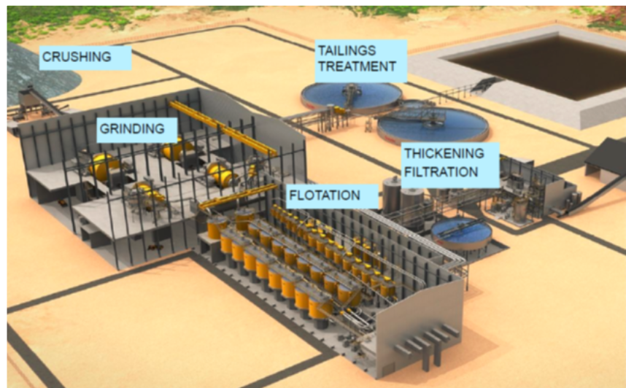
beneficiation processes

Slide 16
beneficiation methods
Flotation
Gravity separation
Magnetic separation
Picking
Electrostatic benefication
Hydrometallurgic benefication

Slide 17
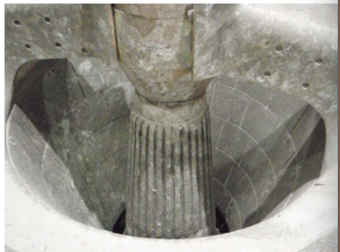
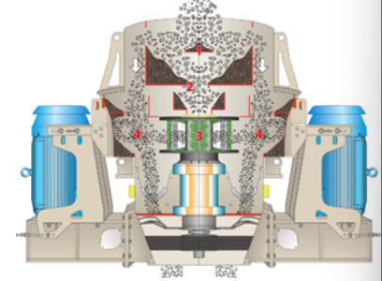
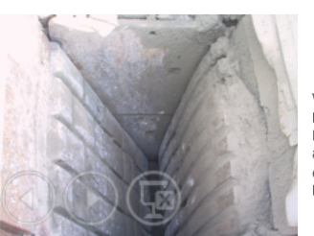
Crushing
Equipments
  - Jaw crushers
  - Gyratory and cone crusher
  - Impact crushers
Crushing circuits

Slide 18
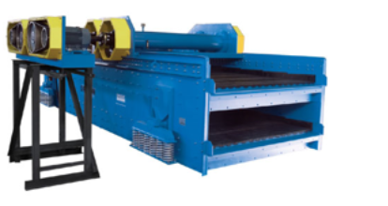
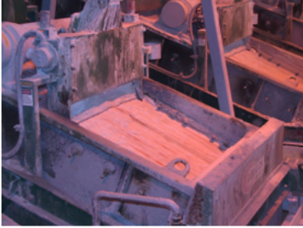
Screening
Vibrating screens
The role of screens is to support crushers
  Returns oversized material to crushing
  Separates fine material that no longer needs to be crushed
The role of wet screens is almost always as classifiers in grinding

Slide 19
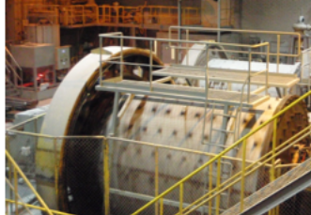
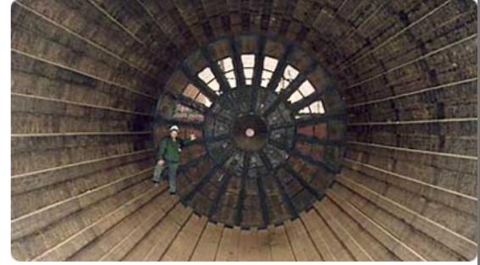
Grinding
Mills
  Ball mill
  Rod mill
  Autogenous mill
  Jet mill
  Other grinding equipment
Grinding circuits

Slide 20
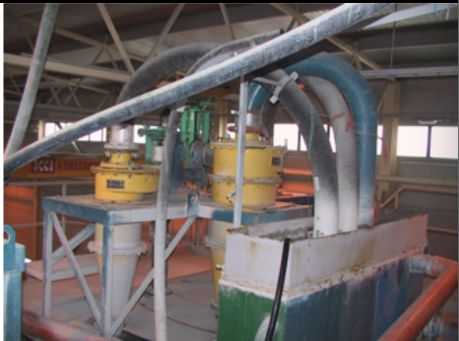
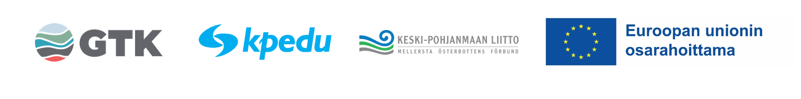
Classification
Cyclones
Wet screens
Rake classifier
Spiral classifier
Often supports grinding in the same sense that screening supports crushing
The role of circulating load is large

Slide 21
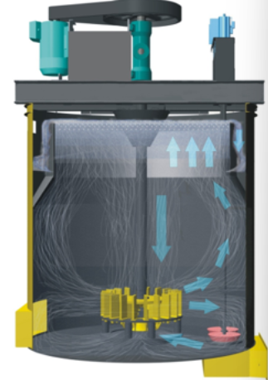
Flotation
The most common ore dressing method
Ore dressing by exploiting diffenrences in
surface chemical properties (hydrophobic surfaces)
Always needs chemicals and air in solution environment
  Collector, frothing agent, activator,
  depressant, pH adjusters
E.g. zinc, copper, nickel, talc and silver minerals

Slide 22
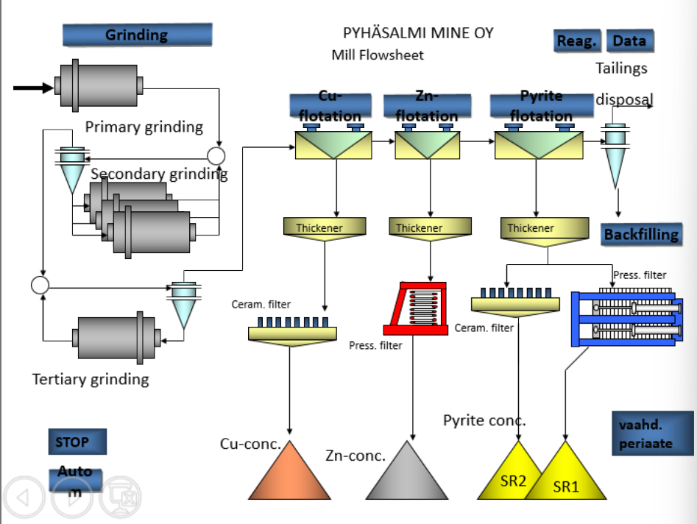

Slide 23
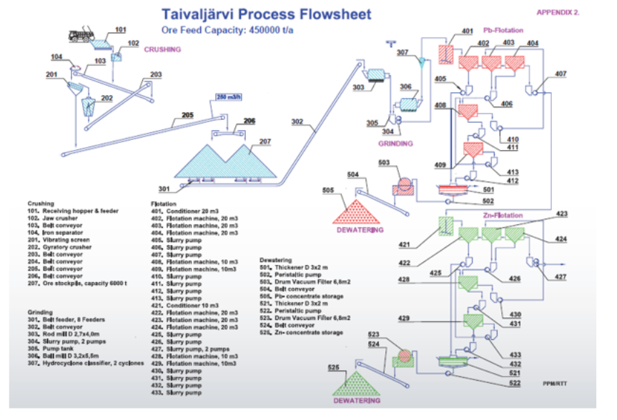

Slide 24
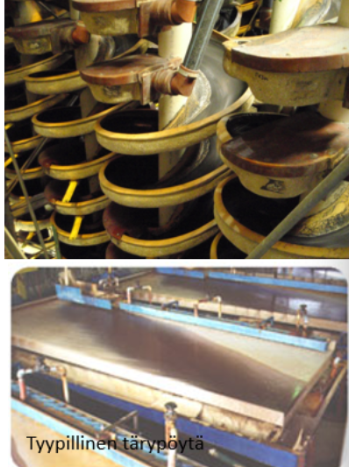
Gravity beneficiation
Gravity / density-based beneficion
Equipment
  Cones (Reichert)
  Spiral separators
  Shaking tables
  Sink-float-units (drums)
  Centrifugal separation (Knelson)
E.g. gold and chromium minerals

Slide 25
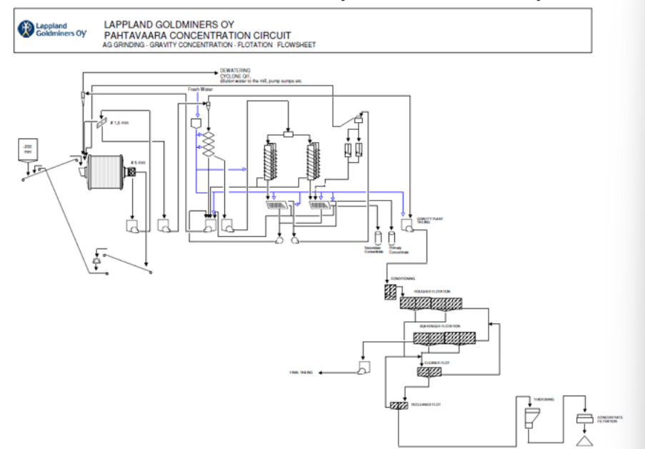
Flowsheet (Pahtavaara)

Slide 26
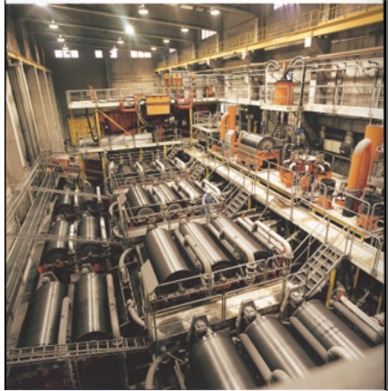
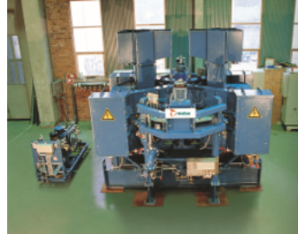
Magnetic separation
Ore dressing which uses magnetic differences
Weak and strong magnetic ore dressing
Equipment
  Roll-type separators
  Magnetic separators
Iron minerals are the most important field of application

Slide 27
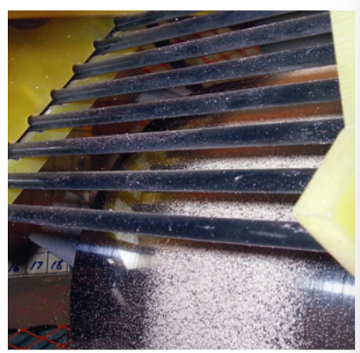
Electrostatic beneficiation
Beneficiation based differences in electrical conductivity.
The techique somewhat resembles magnetic separation, particularly with its roll-type designs.
It is not a very significant mthod today, but new applications are likely to emerge in the future, especially through circular economy solutions.

Slide 28
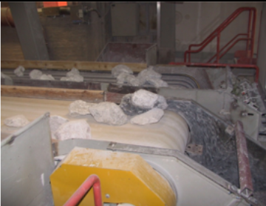
Sorting
The most important application is coarse beneficiation based on optical differences (> 5 mm)
Radioactivity differences can also serve as a basis (e.g. in Canada)
The method orginates from manual hand sorting on coveyor belts, carried out visually.
Today machine vision is often used.
Lime, lithium, uranium etc.

Slide 29
Hydrometallurgical benefication
Leaching-based ”benefiaciation”
  The material is brought into solution
Leaching techniques/pre-treatments
  Bioleaching/tank leaching
  Autoclave leaching
  In situ –leaching
  Roasting
  Chemicals are used to assist processes such as autoclave and tank leaching (e.g. sodium cyanide, especially for gold).
Somewhat newer methods include Platsol (Suhanko) and the Albion Process/Isamill
For uranium, gold, nickel, zinc etc.

Slide 30
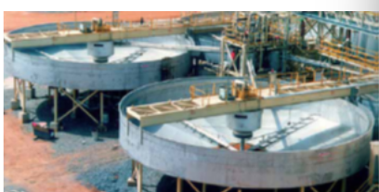
Thickening
The first stage of dewatering
  Carried out using thickeners of various sizes.
Auxiliary chemicals are often used (flocculants)
  Beneficial effects of flocculants: In filtaration
  Adverse effecs of flocculants: In flotation

Slide 31
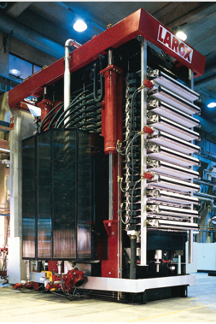
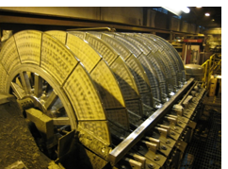
Filtration
The second and often the final stage of dewatering
Most equipment are based on vacuum filtration
  Disk filter
  Drum filter
  Flar bed filter
Pressure filters are also used
  Larox type pressure filter
  Filter press

Slide 32
Drying
A possible third stage of drying (nowadays rare).
Most often carried out in a drum dryer, based on drying powdered material in a warm or hot gas stream.
  The gas is usually air.
Direct or indirects heating can be used.
The development of filtation methods (and tickeners /flocculants) has reduced the need for actual drying.
Still used in individual and special cases.

Slide 33
Battery cluster / Refining
At the present, the overall picture is ultimately quite limited when it comes to new facilities.
Plans are, broadly speaking, almost always based on the idea that nickel and cobalt sulfates are produced from nickel concentrate (which often contains some cobalt), with ammonium sulfate most likely as a by-product.
Of course, the facilities in Kokkola (including som upcoming ones) are an exception to this, with their diverse cobalt products (pCAM) and, in the future, lithium hydroxide.

Slide 34
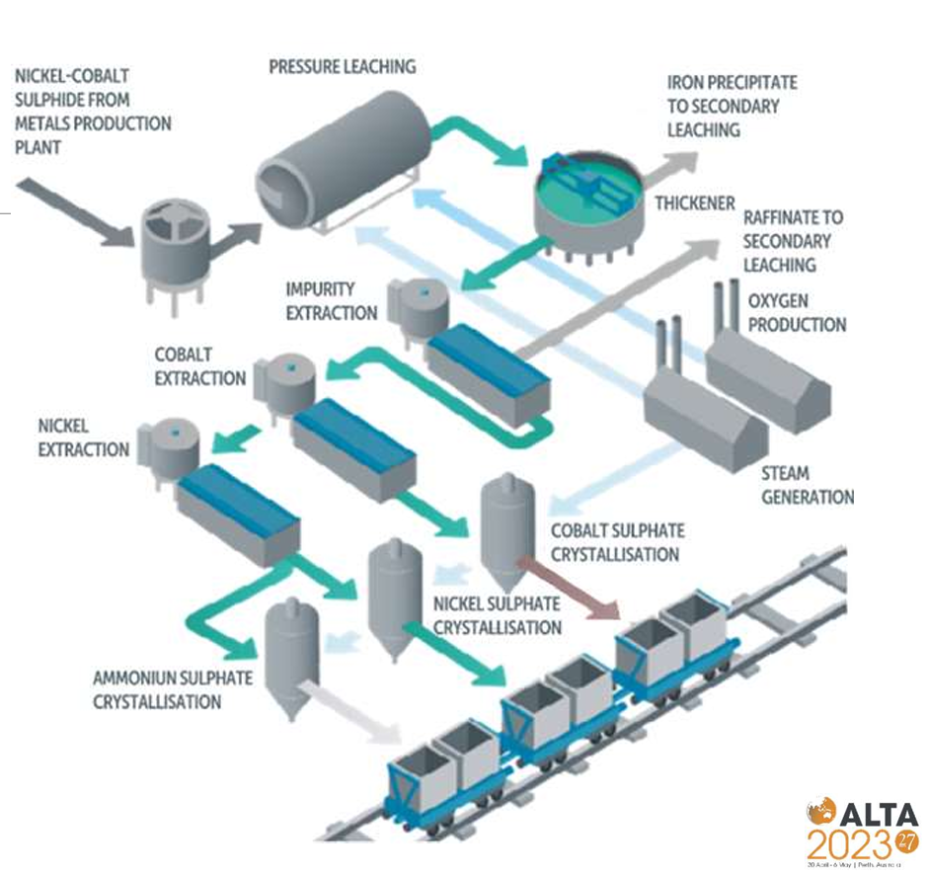
Terrafame battery chemical factory

