Slide 1

The Federation of Education in Central Ostrobothnia
Nea Pitkäkangas

Slide 2
Beneficiation in practice

Slide 3
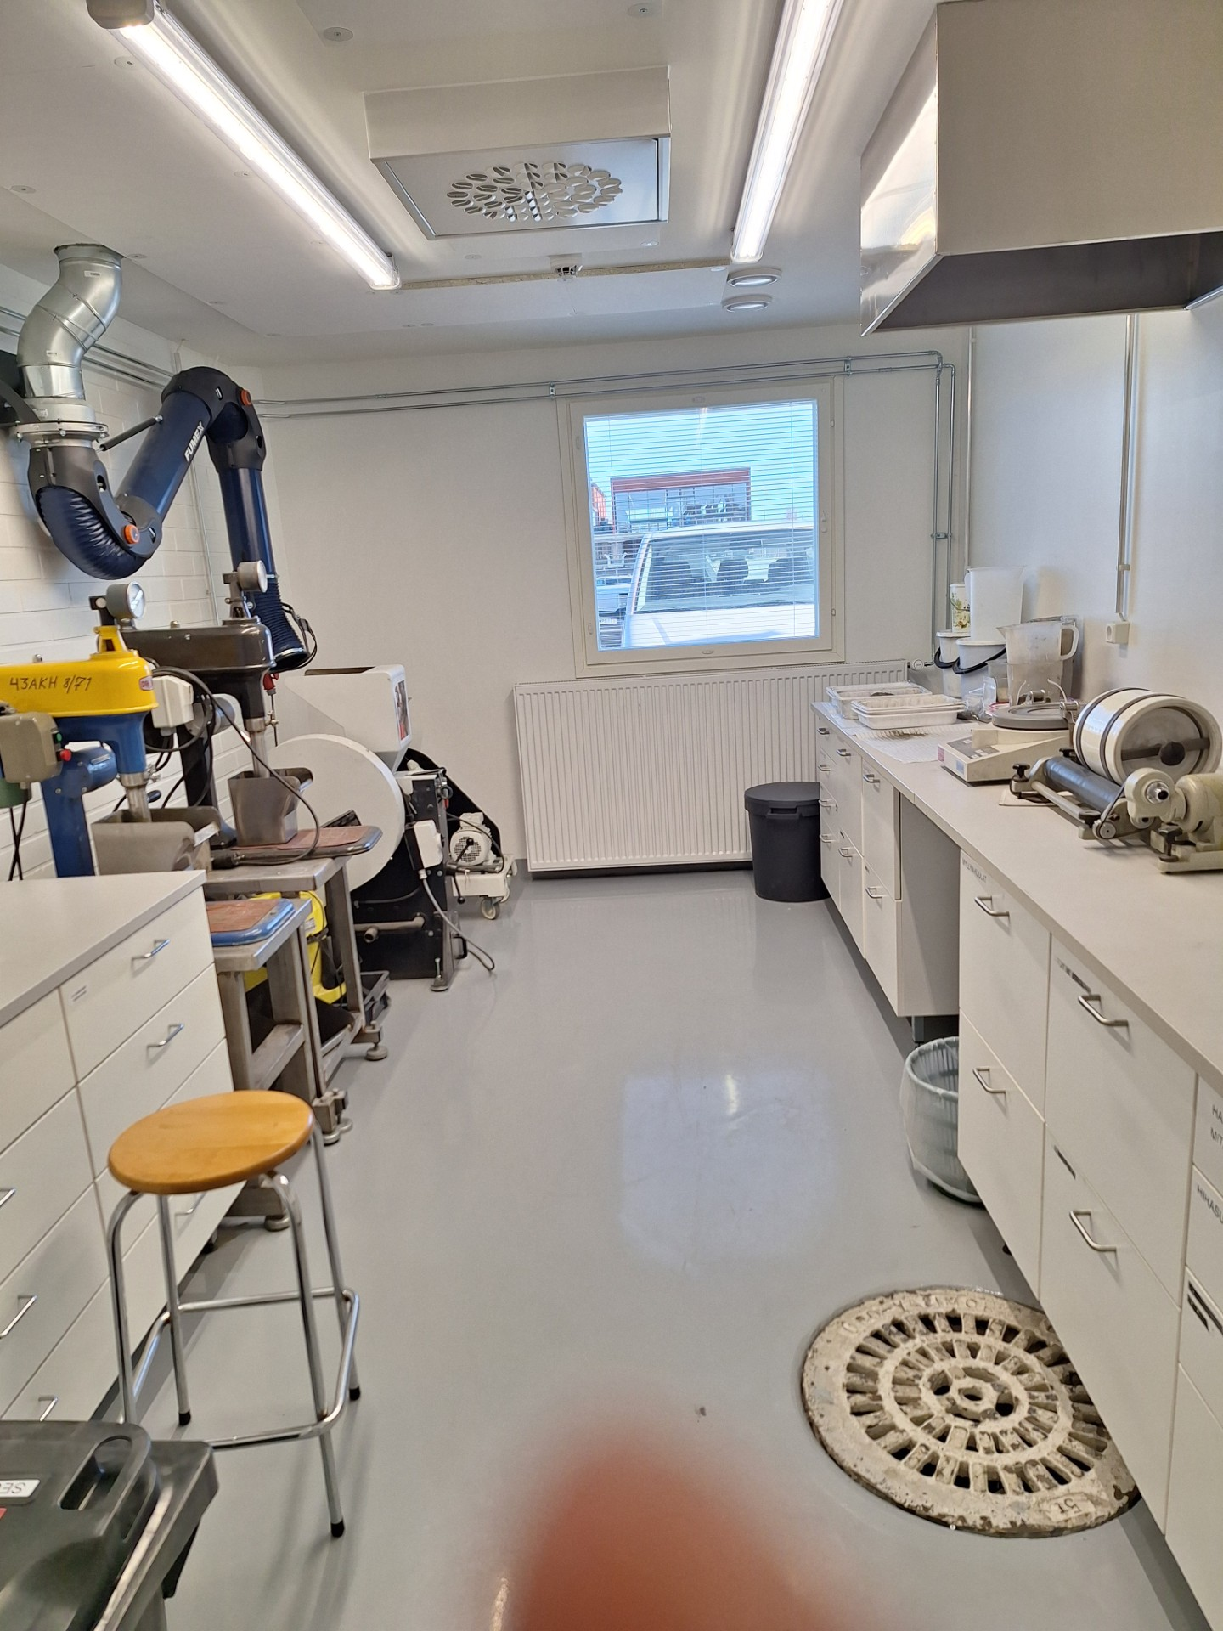
Crushing plant at the school
At the school’s crushing plant ore comminution, screening, and flotation-based beneficiation are carried out.
The equipments:
  Jaw crushers
  Ball mill
  Screens
  Denver flotation cells
  Scale

Slide 4
Training in practice
We have two training assignments that allow our students to practice the unit processes of mineral beneficiation:
1. Copper beneficiation from chalcopyrite
2. Lithium beneficiation from spodumene pegmatite
Chalcopyrite
CuFeS₂
Spodumene pegmatite
LiAl(SiO₃)₂

Slide 5
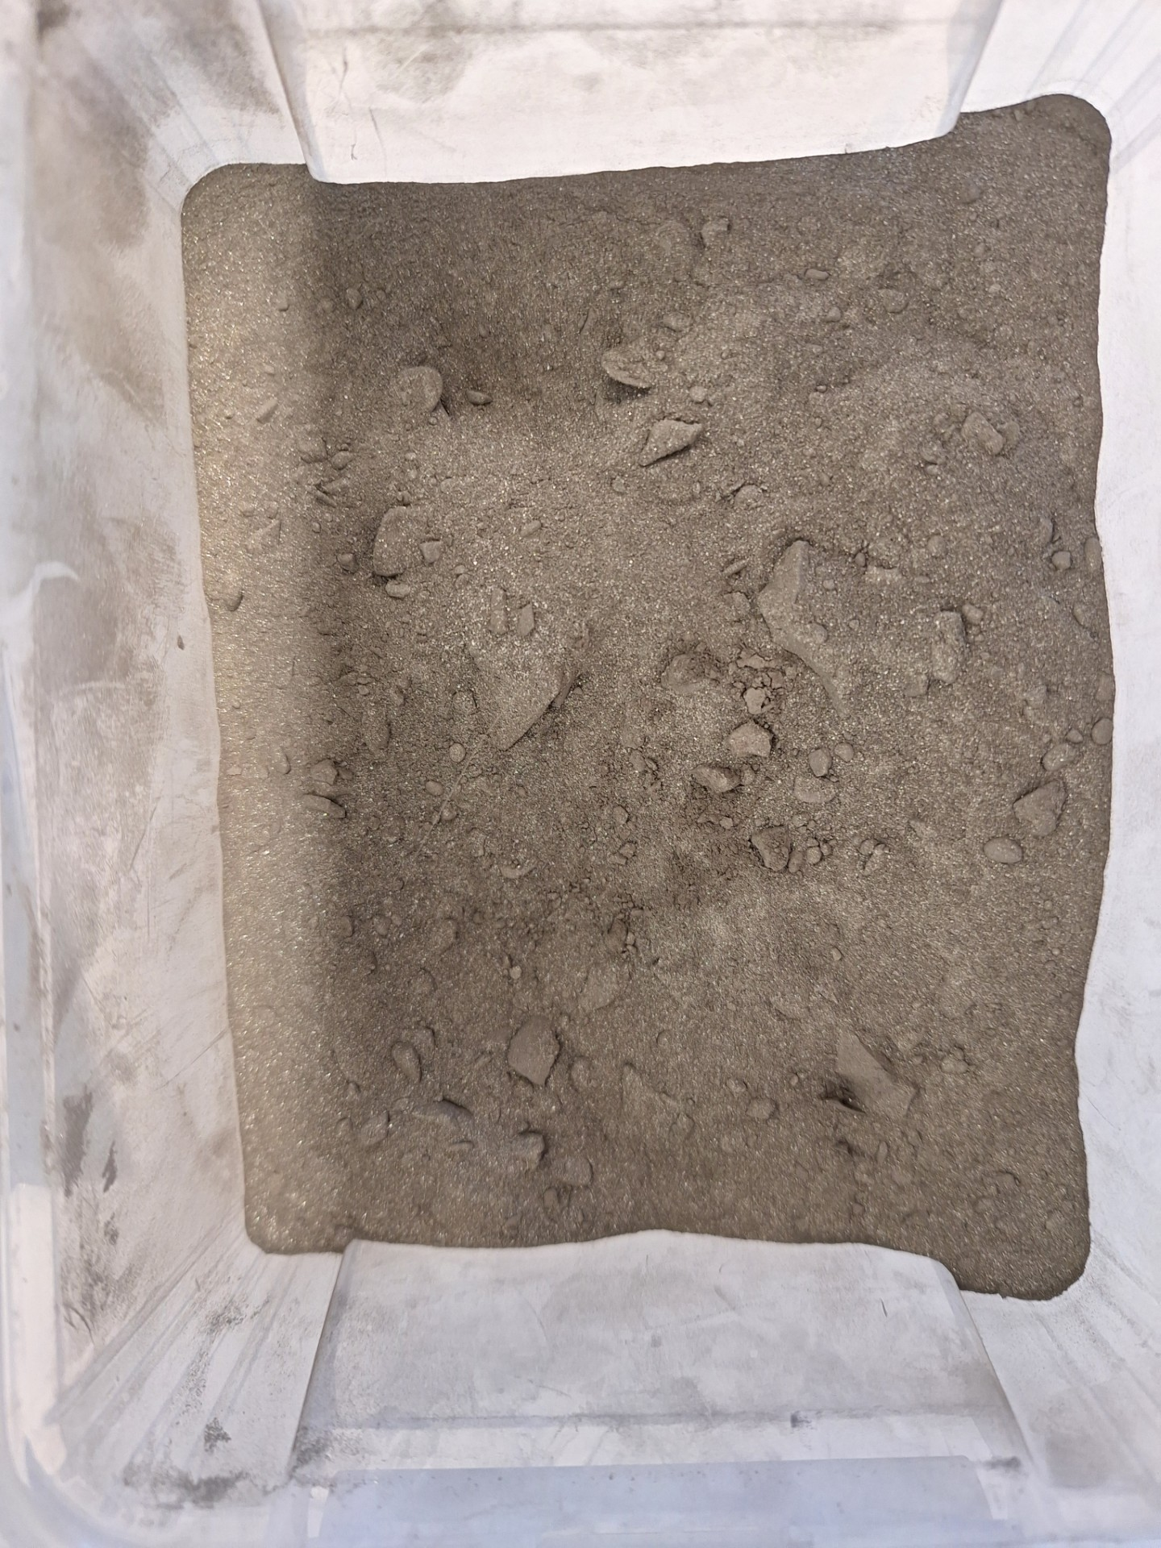
Copper beneficiation from chalcopyrite

Slide 6
Copper beneficiation from chalcopyrite
The purpose in the assignment is to concentrate copper ore with flotation and after that determinate copper concentrations from feed, concentrate and tailings with spectrophotometer.
In the assignment we use ore from Pyhäsalmi mine which includes chalcopyrite, sphalerite and pyrite.
In the assignment we concentrate predominantly chalcopyrite and other minerals stay to large extent after the concentrating to tailings.

Slide 7
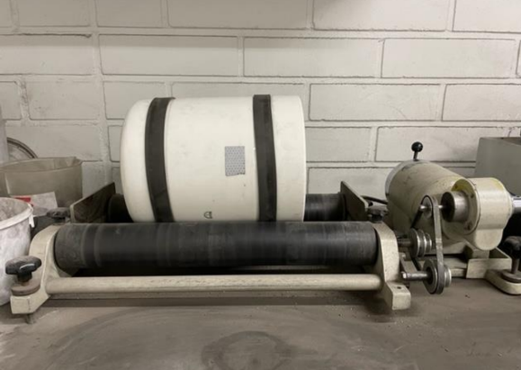
Grinding and screening
The assignment starts with grinding the chalcopyrite ore with ball mill.
The goal of the grinding process is to produce 500 g of ore powder suitable for flotation, with particle size of less than 125 µm.
After grinding, the ore is screened using a vibrating screen with a 125 µm mesh.

Slide 8
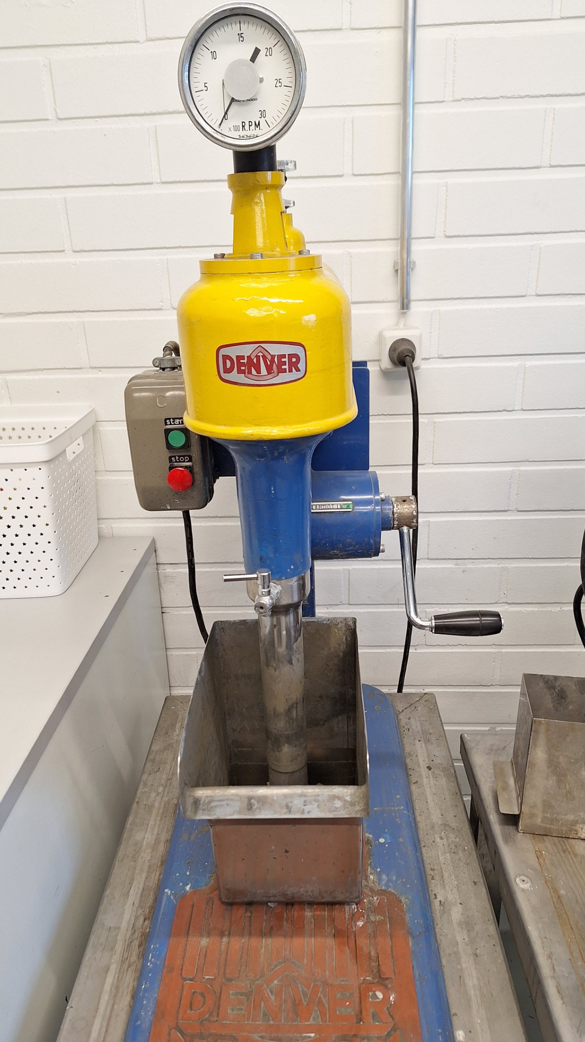
Flotation beneficiation
The flotation is performed using a Denver flotation cell.
Ore with a particle size under 125 µm is placed into the cell, and 2 liters of water are added.
The pH is adjusted to 11 using milk of lime, and the collector reagent, sodium isobutyl xanthate, is added.
The solution is allowed to condition for 15 minutes, after which the frother reagent SylvaPine is added and flotation is initiated.
Skimming of the froth continues as long as the froth remains dark and clearly metallic in appearance.

Slide 9
Filtration and drying
Both the concentrate and tailings are filtered using vacuum filtration with filter paper and a Büchner funnel.
The fractions are placed in a drying oven until completely dry.
Both fractions are then allowed to cool in a desiccator and subsequently weighed.
From the feed, concentrate and tailings 1 g sample is weighed as accurately as possible.

Slide 10
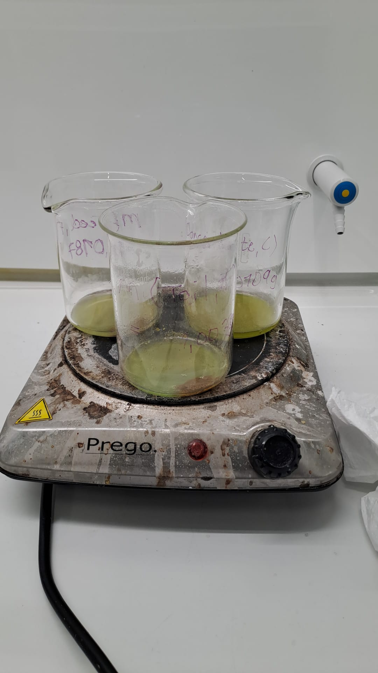
Dissolution
The samples are dissolved in aqua regia (HCl + HNO₃).
After that, any other metals are selectively precipitated by adjusting the pH.
Ammonia is added to the solution, and the pH must be above 9 for iron to precipitate.

Slide 11
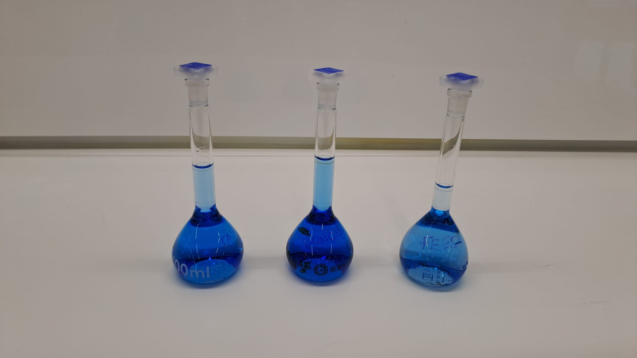
Filtration
The solutions are filtered by gravity using a funnel and filter paper.
The pH of the solution must be above 9 for the blue complex to form.
At this point, the copper content of the samples can be measured using a spectrophotometer.

Slide 12
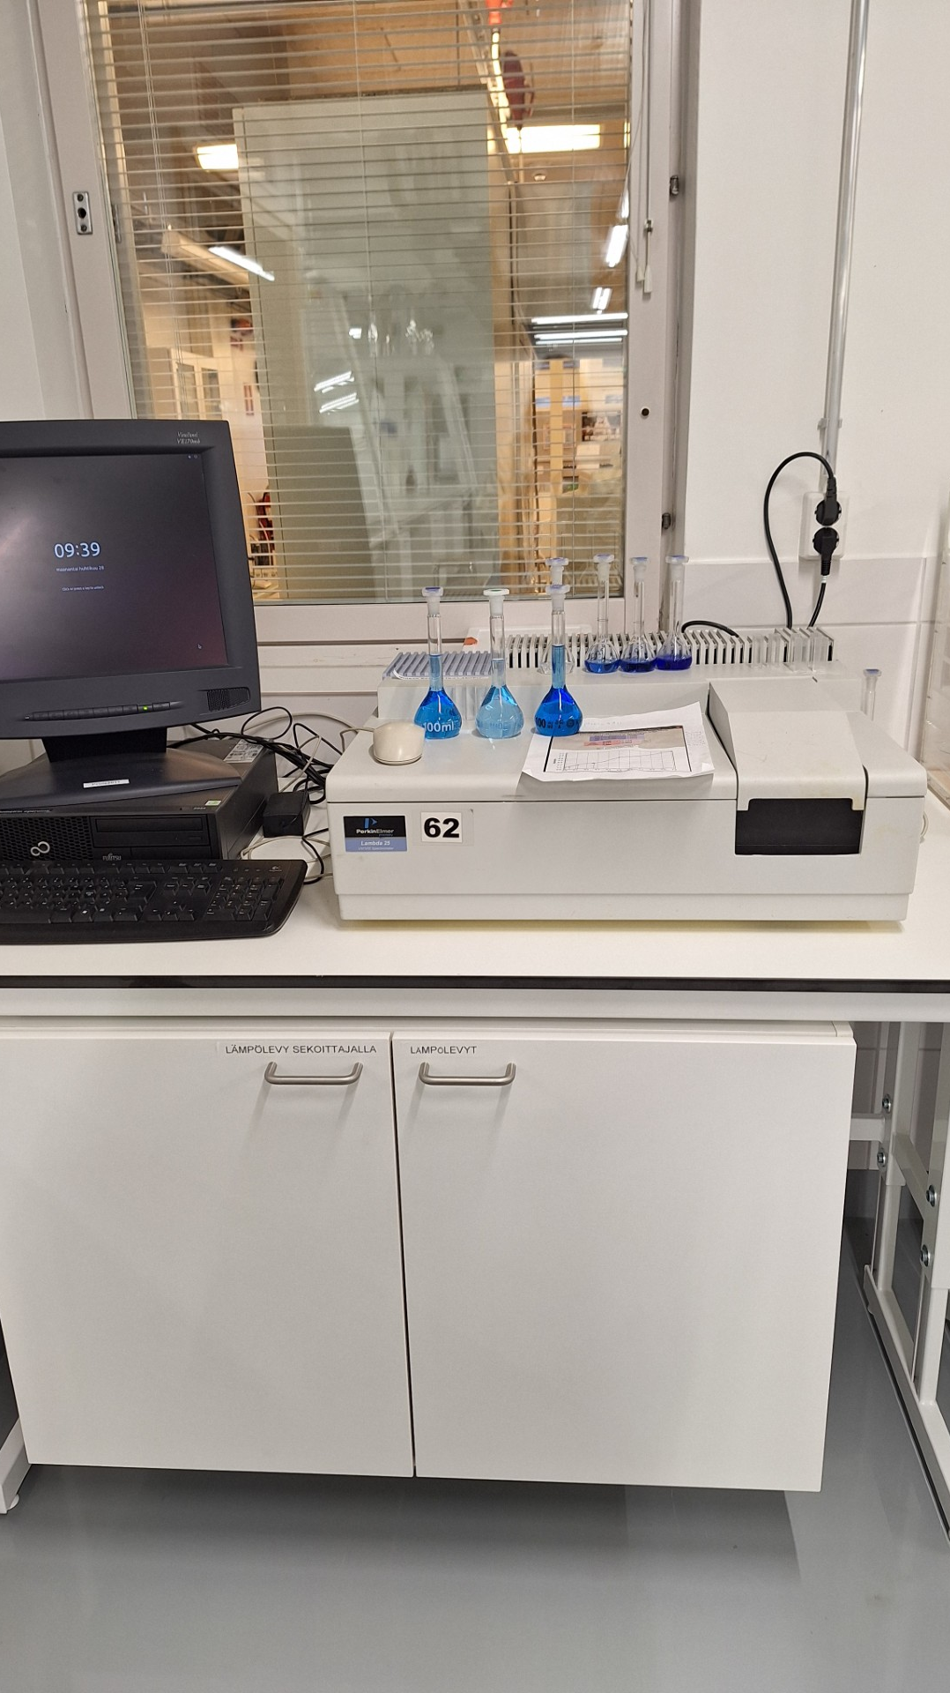
Spectrophotometric determination of copper concentration
The concentration of a substance in this case copper is determined by measuring how much light it absorbs at a specific wavelength.
The amount of absorbed light is proportional to the concentration in the sample (according to the Beer-Lambert law).
In addition, the mass loss is calculated based on the weighing results, both as an absolute value and as a percentage, along with the concentrate ratio and recovery percentage.

Slide 13
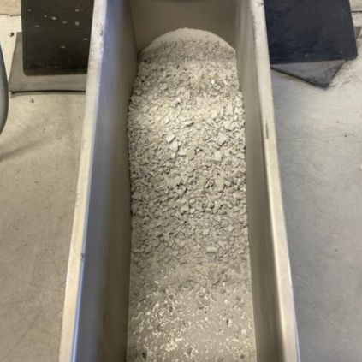
Lithium beneficiation from spodumene pegmatite

Slide 14
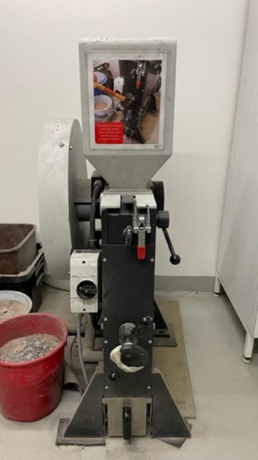
Crushing and grinding
The purpose of the assignment is to concentrate from spodumene pegmatite by flotation.
The beneficiation process begins by crushing ore blocks, approximately 100-200 mm in size, using a jaw crusher in two stages.
After crushing, the material is ground in a ball mill. The goal of the grinding process is to produce 500 g of ore powder suitable for flotation, with particle size of less than 125 µm.

Slide 15
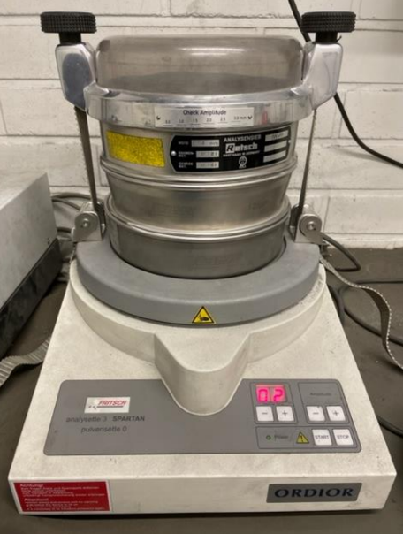
Screening
After grinding, the ore is screened using a vibrating screen with a 125 µm mesh.
The fine fraction that passes through the screen is collected.
The oversize material retained on the screen is returned to grinding if the required 500 g of undersize is not achieved on the first attempt.

Slide 16
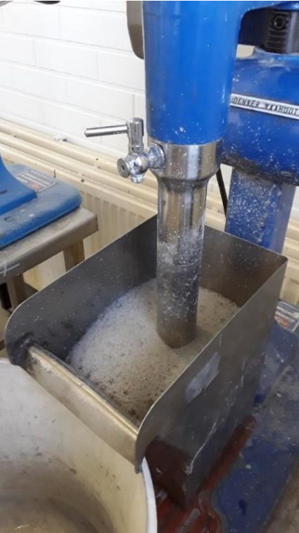
Flotation beneficiation
The beneficiation is carried out through flotation, using a 2-liter Denver flotation cell.
In the first stage, the pH is adjusted to alkaline with NaOH, and flotation reagent Berol 050 and rape fatty acid are added and allowed to condition.
After this, a prefloat flotation is performed.
  The overflow is discarded as waste.

Slide 17
Flotation and filtration
The pH of the underflow is adjusted after prefloat flotation to 7,5 using sulfuric acid, and new flotation reagents are added and allowed to condition.
A new flotation process is initiated, and the froth is collected.
The underflow is now considered as waste.
To recover as much lithium as possible, scavenging is performed at least three times.
The resulting slurries are filtered and allowed to dry.
After that they are weighed and quantitatively transferred to crucibles for calcination.
Notes:
Riperikastus = Scavenging

Slide 18
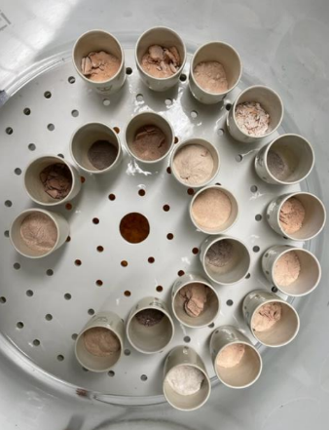
Calcination
The samples are calcined in a muffle furnace for 2 hours at a temperature of 950 °C.
During calcination, alpha spodumene is converted to beta spodumene.
This step is essential because alpha spodumene does not dissolve in even concentrated acid solutions, whereas beta spodumene is soluble.

Slide 19
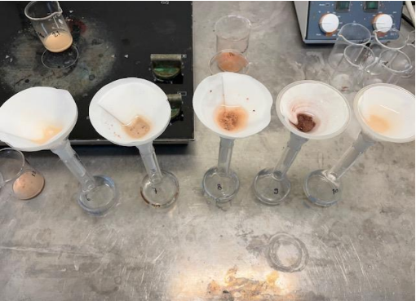
Dissolutiuon
After calcination, the samples are cooled and dissolved in concentrated, hot acid solution (HCl and H₂SO₄)
After acid dissolution, ion-exchanged water is added to the samples, and the solutions are gravity filtered using filter paper into 100 ml bottles.

Slide 20
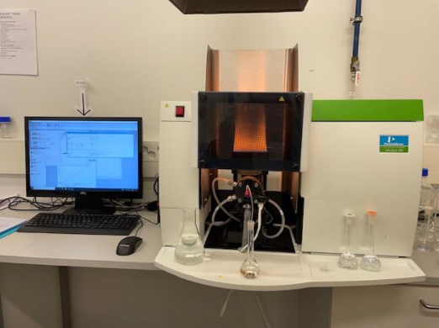
Determination of lithium concentration using AAS
The samples are analyzed using an atomic absorption spectrometer (AAS).
AAS works by passing light through a sample vaporized in a flame or graphite furnace.
The atoms in the sample absorb light at specific wavelengths, and the amount of absorption is measured.
This absorption is proportional to the concentration of the element in the sample, in this case lithium.
The results show approximately 30-55 mg of lithium per 1 g of feed.

Slide 21
Thank you!
@kpedufi
@Keski-Pohjanmaan ammattiopisto
Nea Pitkäkangas
+358403596221
nea.pitkakangas@kpedu.fi
@Keski-Pohjanmaan ammattiopisto
@KpeduFI
www.kpedu.fi

